Slide 1


Investigating Websites
ONEFOOTBALL
Netflix
Edmund Martei

Slide 2
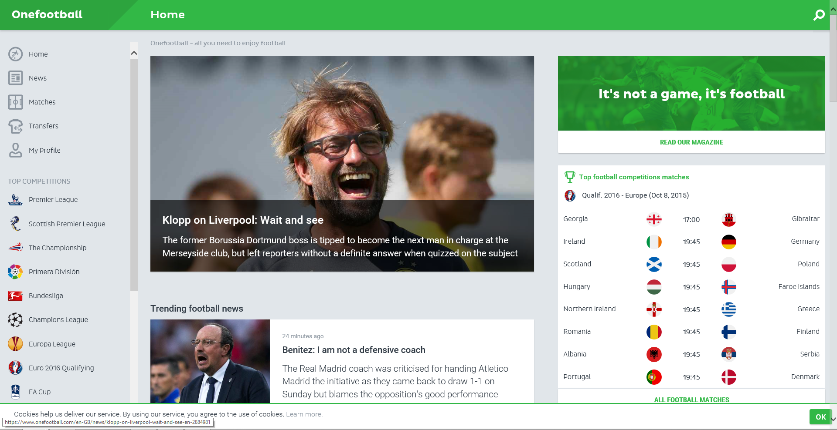
One Football
Onefootball is a football application that provide users with news, scores, results, tables and stats for 140 leagues worldwide.
Users use this website to check on the stats and performance of their favourite team, and live matches, share their thought on previous matches and comment

Slide 3
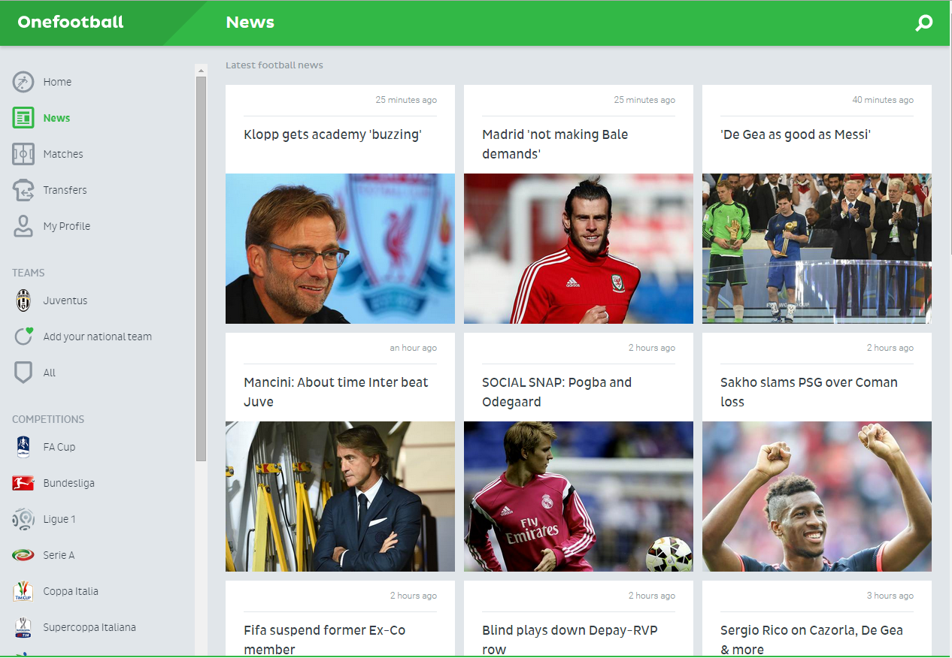
Accessibility
Really easy to use you have your home button home, news, matches, transfers, my profile on the left of the page.
Everyone can create a profile with one of the major social networks.
It have links, when you click on the picture or the text below the picture it takes you to the full article of the news

Slide 4
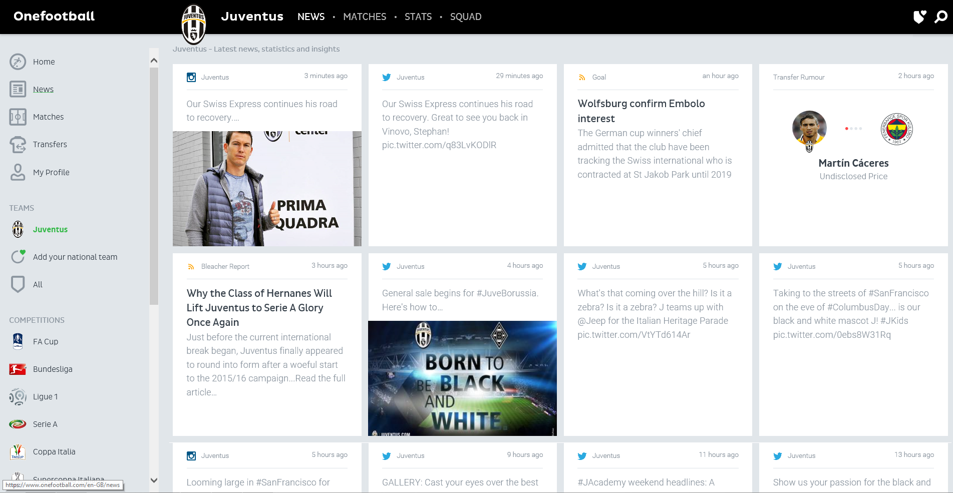

Strength:
View post from the player and the club on twitter.
Chose your team and league you want to follow.
Get transfer news official and rumoured .
Available for all major mobile platform.
Weakness:
Sometimes it doesn’t load the pages.
Notes:
Features : login links search accessibility
remember netflix

Slide 5
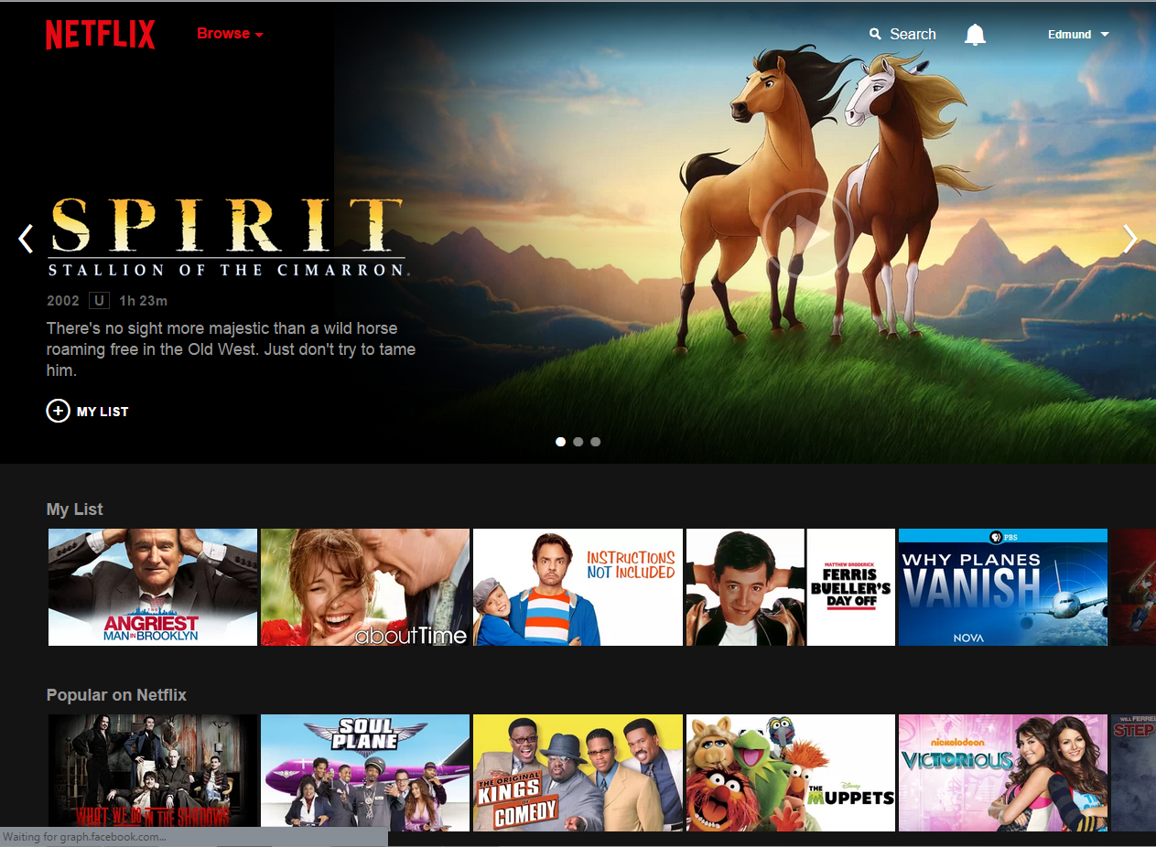
Netflix
Netflix it’s a video service website users use it to watch movies, tv shows, documentary, and Netflix own original shows.
The home page its really easy you get big pictures of the movies you want to watch .
You have a search bar, a reminder and a button for managing your account.
On the homepage you get recommendation for movies you’ve already watch or saved to watch later.
Or popular movie and tv shows

Slide 6
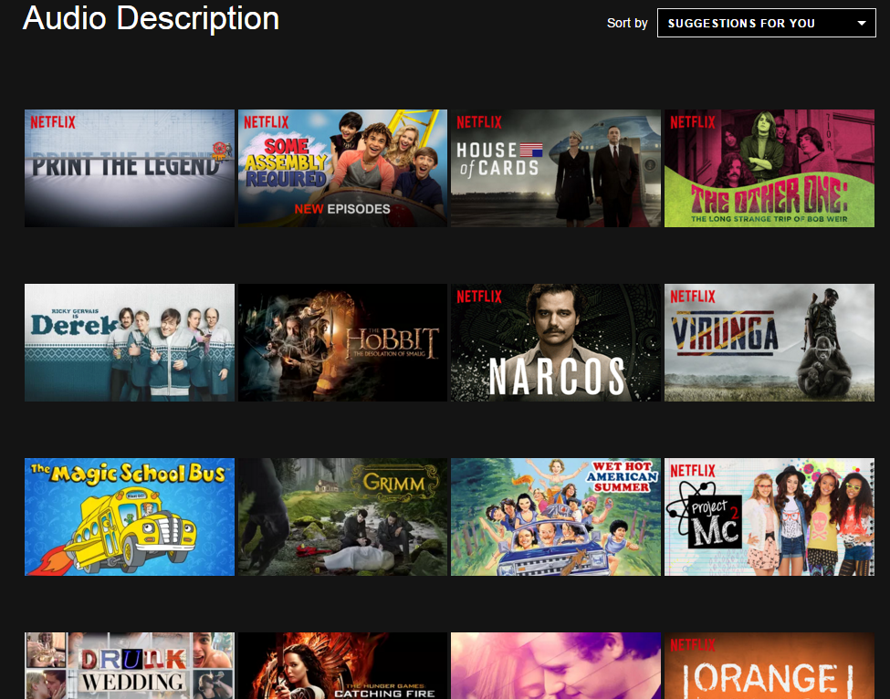
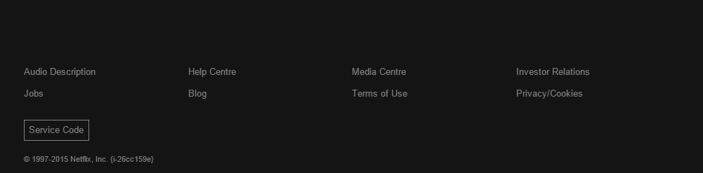
accessibility
Blog
Help centre: contains FAQ and tips
Audio description: describes what is happening on-screen, including physical actions, facial expressions, costumes, settings and scene changes. Customers can enable audio narration

Slide 7


Strength:
Watch movies, tv shows with any device pc, tablet, phones.
Create multiple profile.
Watch movie in High definition and 4k available for some movies, shows.
Weakness:
Can’t share account
Not available all over the world except for north and south America and Europe.

